Slide 1
Introduction to Uppaal
ITV Distributed Real-Time Systems
Anders P. Ravn
Aalborg University
September 2006

Slide 2
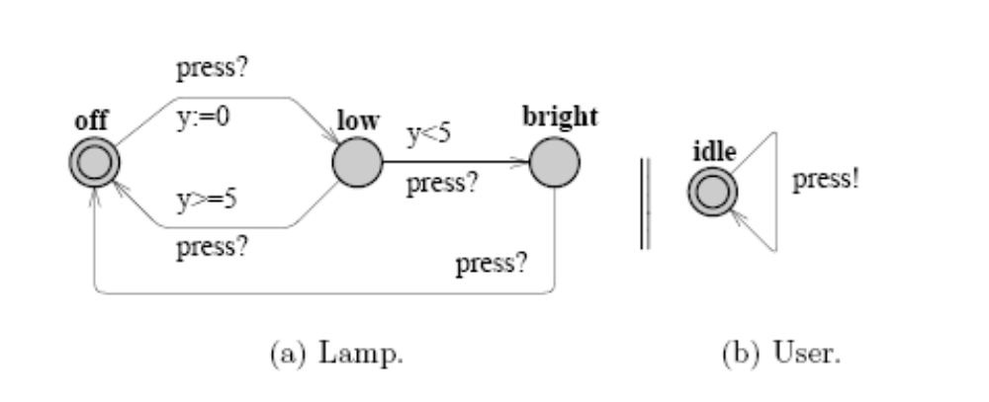
Networks of Timed Automata

Slide 3
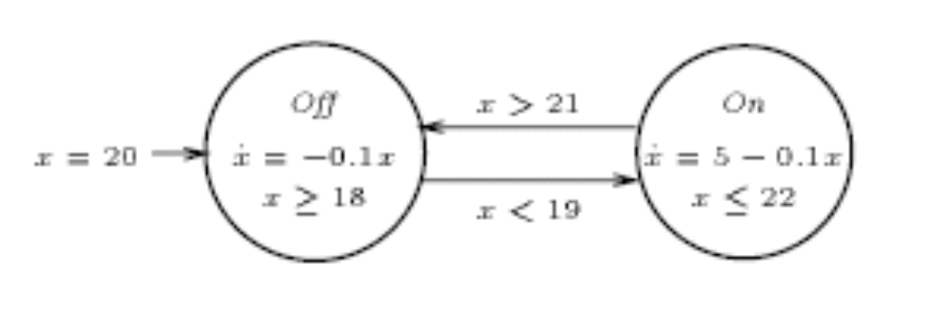
Hybrid Automaton - Syntax
X = {x₁, … x_{n}} - variables
(V, E) – control graph
init: V → pred(X)
inv: V → pred(X)
jump: E → pred(X ∪ X’)
event: E → Σ
.
α
x’ = x-1
β

Slide 4
Labelled Transition Systems
Q – states, e.g. (v=”Off”,x = 17.5)
Q⁰ – initial states, Q⁰ ⊆ Q
A – labels
→ – ransition relation, A → Q×Q
a
a
post_{a}(R) = { q’ | q ∈ R and q → q’}
pre_{a}(R) = { q | q’ ∈ R and q → q’}
a

Slide 5
Transition Semantics of HA
X = {x₁, … x_{n}} - variables
(V, E) – control graph
init: V → pred(X)
inv: V → pred(X)
jump: E → pred(X ∪ X’)
event: E → Σ
α
x’ = x-1
.
β
Q - states – {(v,x) | v ∈ V and inv(v)[X := x]}
Q⁰ – initial states - {(v,x)∈ Q | init(v)[X := x]}
A - labels - Σ ∪ R_{≥0}
{ (v,x) – α→ (v’,x’) | e ∈ E(v,v’) and
event(e) = α and jump(e) [X := x]}
{ (v,x) – δ→ (v,x+ δ) | δ ∈ R≥0}
.

Slide 6
Trace Semantics
Q - states, {(v,x) | v ∈ V and inv(v)[X := x]}
Q⁰ – initial states, …
A - labels, …
→ - transition relation, A → Q×Q
a
Trajectory: ρ = <(a₀,q₀)…(a_{i},q_{i})…>
where q₀ ∈ Q⁰ and q_{i}–a_{i}→q_{i+1}, i≥ 0
Live Transition System: (S, L = {ρ | infinite from S})
Machine Closed: ρ finite from S, ρ ∈ prefix(L)
Duration of ρ is sum of time labels.
S is non-Zeno: duration of ρ ∈ L diverges, Machine closed

Slide 7
Composition of Transition Systems
Q - states
Q⁰ – initial states, …
A - labels, …
→ - transition relation, A → Q×Q
a
S = S1 || S2
with
⊗ : A1 × A2 → A
Q = Q1× Q2
Q⁰ = Q1⁰ × Q2⁰
(q1,q2) –a→ (q1’,q2’) iff
(qi –ai→ qi’, i=1,2 and
a = a1⊗a2
Remark p 7

Slide 8
Verification Tasks
Reachability of (v,x)
– finitary, time-abstract trace inclusion
Emptiness
– time-abstract trace inclusion
Trace (finitary) inclusion
Time-abstract (finitary) trace inclusion

Slide 9
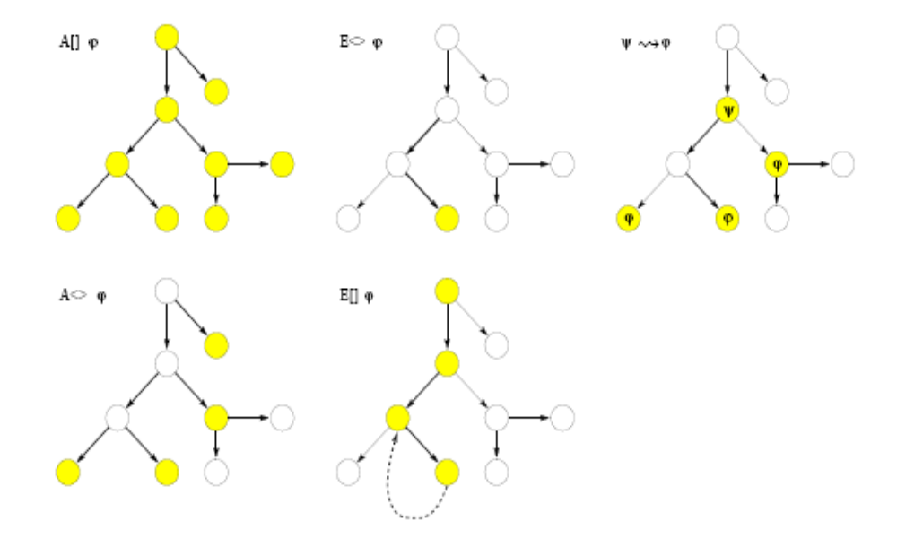
CTL

